Slide 1
DIT341 - Lecture 10:
Mobile Development with Android (2)
Gregory Gay
(Some slides by Grischa Liebel)

Slide 2
This Lecture
Testing
Profiling
Processes and Threads
Services
Broadcast Receivers
Content Providers (if we have time)

Slide 3
Related Activities
Activity 21: Optional
Practice Android with Codelabs for Android Developer Fundamentals (V2):
https://developer.android.com/courses/fundamentals-training/toc-v2
2.2: Activity lifecycle and state
4.1: Clickable images
4.2: Input controls
4.3: Menus and pickers
4.4: User navigation
4.5: RecyclerView

Slide 4
Testing and Profiling

Slide 5
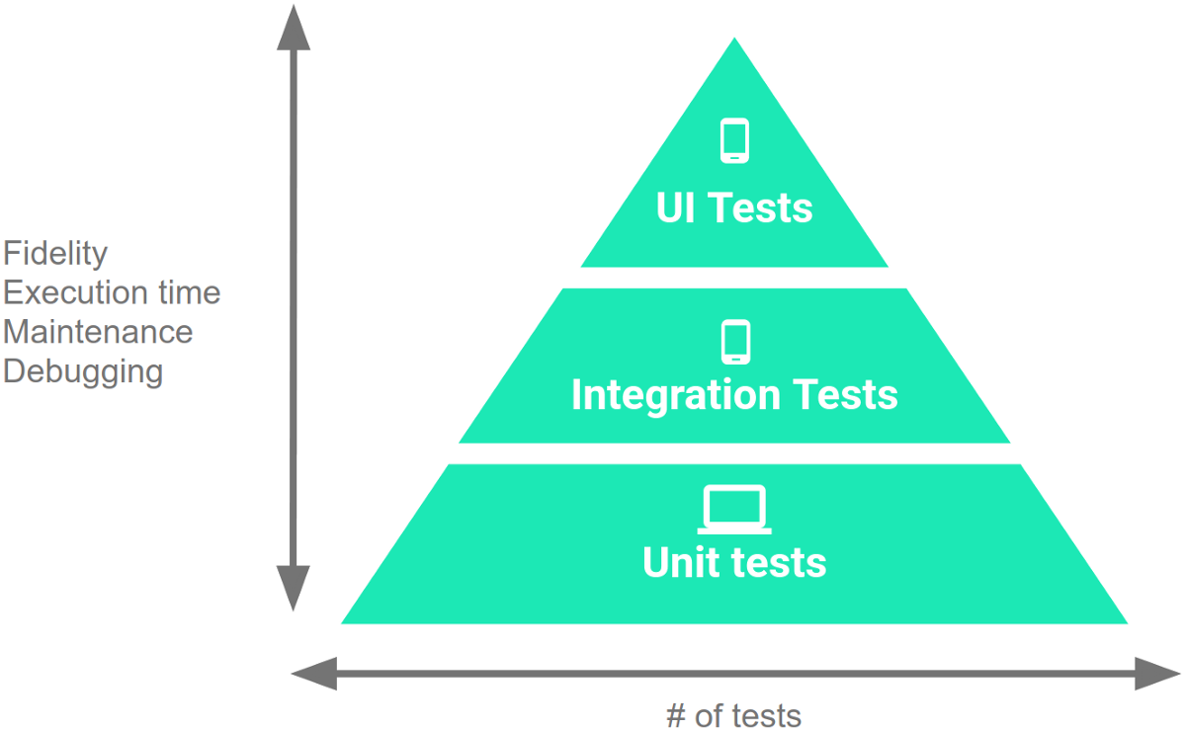
Testing
Unit tests verify behavior of a single class.
70% of your tests.
Integration tests verify class interactions in a portion of the app.
20% of your tests.
UI tests verify end-to-end journey over the app.
10% of your tests.
Notes:
Before your app enters the hands of users, it is crucial to test it. Tests in Android typically come in three forms, ordered by both the level of granularity and the volume of testing that should be conducted.
Unit tests validate your app's behavior one class at a time. These are written in JUnit, like the unit tests for any Java app. You initialize classes, call the methods of those classes, and check the results. As much as possible, you attempt to test that class in isolation, separate from other classes and external dependencies.
Integration tests validate either interactions between levels of the stack within a module - a cluster of classes-, or interactions between related modules.
End-to-end tests, generally done through the UI, that validate user journeys spanning multiple modules of your app.

Slide 6
Testing
70/20/10 recommended.
Unit tests execute quickly, without emulator or devices.
UI tests must run in Android, are very slow.
Well-tested units reduce likelihood of integration issues, making high levels of testing easier.
Notes:
Google generally recommends a split of: 70 percent small, 20 percent medium, and 10 percent large. The reason for this is that as you work up the pyramid, from smal unitl tests to large UI tests, each test increases in fidelity but also increases in execution time and effort to maintain and debug. Therefore, you should write more unit tests than integration tests, and more integration tests than end-to-end tests. Unit tests run through the command line, on the machine you use to develop the app. They run quickly, in milliseconds, without an emulator or device. UI tests must run in Android, on the live app, so they require emulators or physical devices. You should run them on multiple devices too. This dramatically increases the requires execution time. UI tests are also often more complex, so they require more maintenance effort too. The good news is that this split also works out even without the speed factor. Units are tested in isolation. Well-tested units should integrate more cleanly - if there are issues, they are due to the integration itself and not a problem solely in one unit. Creating more unit tests makes the other levels easier as well. Cheaper and easier.

Slide 7
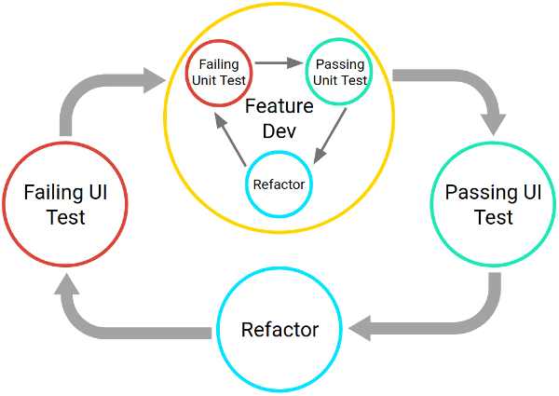
Testing Lifecycle
Create and test code in iterative cycles.
Write test cases before you code!
It will fail until you finish the feature (correctly).
Development is a series of nested cycles.
Features tested, and integrated (tested via UI)
Notes:
You should create and test code iteratively. When developing a feature iteratively, you should start by either writing a new test or by adding cases and assertions to an existing unit test. The test fails at first because the feature isn't implemented yet. This is called test-driven development. Why write a test before writing code? Because it makes you think through the behavior of that feature. THis reduces the likelihood of making a mistake. It also gives you the ability to test your feature instantly once it is implemented. The test will pass when the feature is completed CORRECTLY.
The full developpment cycle then contains a series of nested, iterative cycles where a long, slow, UI-driven cycle tests the integration of code units. You test the units themselves using shorter, faster development cycles. This set of cycles continues until your app is complete.

Slide 8
Thinking in Terms of Modules
Develop and test app as a set of modules.
Clusters of classes centered around a task.
Business logic, UI elements, data.
Ex: Task List App
Creating tasks, viewing stats, attaching photographs
Allows iterative completion of app, independent testing of features.
Create consistent APIs to allow modules to interact
Set well-defined boundaries around modules.
Notes:
To make your code easier to test, develop your code in terms of modules, where each module represents a specific task that users complete within your app. Each module will form a set of classes, encompassing UI elements, underlying business logic, and data.
For example, a "task list" app might have modules for creating tasks, viewing statistics about completed tasks, and taking photographs to associate with a particular task. This way of thinking allows you to split up development, think about one aspect of the app at a time, and organize both the code and testing efforts. A modular architecture helps you keep unrelated classes decoupled and independent.
It's important to set well-defined boundaries around each module, and to create new modules as your app grows in scale and complexity. Each module should have only one area of focus, and the APIs that allow for inter-module communication should be consistent.

Slide 9
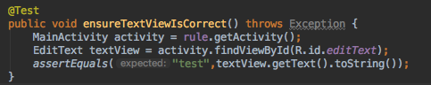
Unit Testing
Test each class (or smallest unit) in isolation.
Test standard interactions, invalid inputs, resource availability (network, files, database).
Tests written in JUnit 4.
AndroidX Test Library provides resources, allows tests to run locally.
Notes:
It's important to consider the units of responsibility that emerge as you design the new feature. For each unit, you write one or more corresponding unit tests. Your unit tests should nearly exhaust all possible interactions with the unit, including standard interactions, invalid inputs, and cases where resources aren't available.As you add and change methods within a particular class, create and run unit tests against them.
(last two points).

Slide 10
Testing in Isolation
Mock objects (AKA: test doubles) can be used to replace dependencies.
Simple replacements that offer static answers to method calls and queries.
If you’ve already tested dependencies, use those!
If not, use mock objects.
Mock objects also good for long operations, hard to create configurations.
Mockito library enables mocking.
Notes:
Units often rely on other units or external dependencies. When creating tests, you have the option of creating real objects or test doubles, such as fake objects or mock objects. (2-4) to allow isolated testing without relying on code that may have problems. it's better to create mock objects if your tests try to perform the Long operations, such as processing a large file.
or Hard-to-create configuration - weird error conditions like a particular database or network configuration. (last)

Slide 11
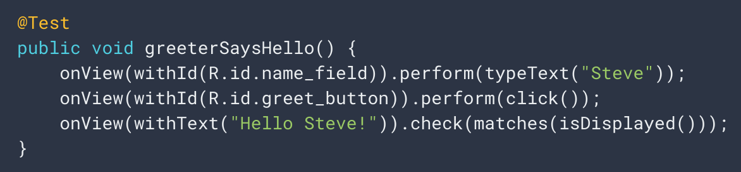
UI Testing
Espresso library enables UI testing through JUnit.
Get views - onView(withId(R.id.my_view))
Perform actions - View.perform(click())
Check results - View.check(matches(isDisplayed()))
Notes:
go over
test types steve into box, click the button, checks that the display says “Hello Steve” in response

Slide 12
Unit Test Example
Uses Espresso testing libraries to interact with Views and Intents.
(Part of AndroidX)
@Test
public void successfulLogin() {
LoginActivity activity = ActivityScenario.launch(LoginActivity.class); onView(withId(R.id.user_name)).perform(typeText(“test_user”)); onView(withId(R.id.password)) .perform(typeText(“correct_password”)); onView(withId(R.id.button)).perform(click()); assertThat(getIntents().first()) .hasComponentClass(HomeActivity.class);
}
Notes:
Lets go over another example unit test that uses Espresso. We use the new ActivityScenario API to launch the LoginActivity. This creates the activity and brings it to the resumed state, where it is visible to the user and ready for input. ActivityScenario handles all the synchronization with the system and provides support for common scenarios you should be testing such as how your app handles being destroyed and recreated by the system.
We use the Espresso view interaction library to enter text into two text fields and click a button in the UI. Similar to ActivityScenario, Espresso handles multi-threading and synchronization for you and surfaces a readable and fluent API to author tests with.
We use the Intents.getIntents() Espresso API to returns a list of captured intents. We then verify the captured intents using IntentSubject.assertThat(), part of the new Android Truth extensions. The Android Truth extension provides an expressive and readable API to validate states of fundamental Android framework objects.

Slide 13

Smoke Testing
Does it start smoking when you turn it on?
Extremely basic tests of functionality.
Simple starting point for testing.
Quick check that all functions work at a basic level.
Avoid running UI tests every time, just some of the most important at critical points.
i.e., login, logout, creating a new account, page loads
If smoke tests fail, run deeper tests.
Notes:
Smoke testing is a practice that asks (1). This is (2-4). Why do this? we don’t want to run all of our UI tests every single time. UI tests take a long time to run when compared to pretty much every other type of automated test. We do, however, want to run some of the most important tests at critical points. For instance, you might have some quick tests of high level features like login, logout, creating a new account, loading a page. One can easily see how running a subset of your full test suite can save hours of time in a week, which can lead to saving thousands per year. Quick sanity check, and save heavyduty testing for important times (or if a smoke test fails).

Slide 14
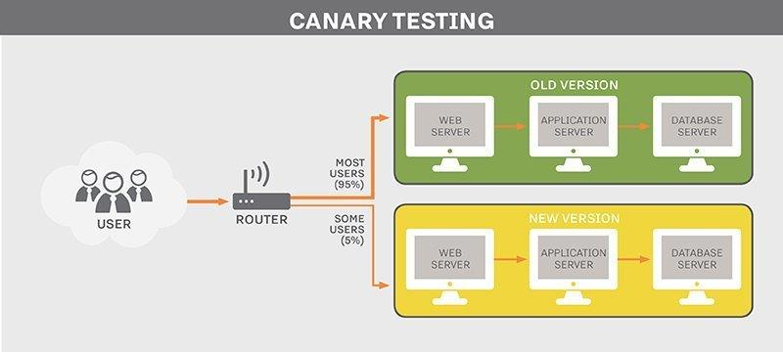
Canary Testing
Push changes to a small subset of users.
Users do not volunteer.
Ensures code changes work in a real environment.
If there is a problem, you can revert changes quickly.
Only small subset of users impacted.
Can be automated.
Notes:
Canary testing allows you to test features in the real world. (1). This is different from beta testing - (2). It (3-5). This can also be automated. Once test pass, you can automatically choose a random set of users and push the update to them.

Slide 15

Monkey Testing
Automatically stress test an app by attacking with random input.
UI tests not exhaustive.
Monkey good for “filling in some gaps”.
Tool included in Android SDK.
Generates random keystrokes, touches, and gestures.
Run through command line.

Slide 16
Demonstration - Monkey Testing
Notes:
open emulator
adb shell monkey -p com.example.myfirstapp -v 1000
adb shell monkey -p se.chalmers.cse.dit341.group00 -v 1000

Slide 17
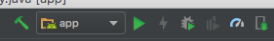
Profiling
Used to investigate performance of your app.
Tool included in Android Studio.
Find expensive computations.
Shows how app uses CPU, memory, network, battery
Important to understand how to optimize the UX.
Notes:
The Android Profiler tools provide real-time data to help you to understand how your app uses CPU, memory, network, and battery resources. This is a tool included in Android studio, activated using the little meter symbol. The tool shows you where your app is acting in suboptimal ways - using too much memory or CPU, consuming more battery life, downloading when it shouldn’t. This is an essential tool in understanding how to improve the user experience with your app.

Slide 18
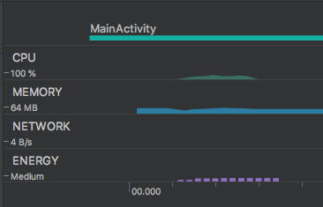
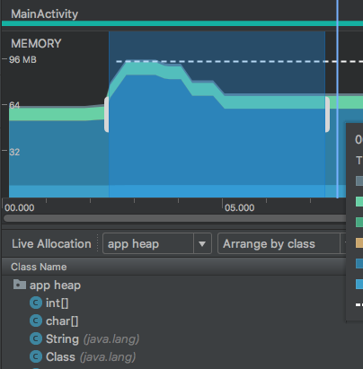
Profiling
Detailed views on
CPU
Memory allocation
Network traffic
Energy consumption
Notes:
go over graphs
see change over time, point out bottlenecks

Slide 19
Backend Processing

Slide 20
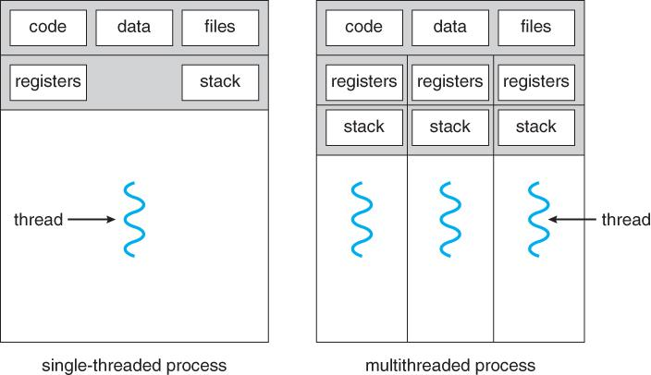
Processes and Threads
Independent sequences of execution.
A running program is a process.
Allocated memory, executable code, connections to OS.
A process has one or more threads.
Each process has a “main/primary” thread.
Processes are isolated from each other.
Communication between processes is expensive.
Notes:
I imagine you’ve talked basics before, but a little review. Processes and threads are (1), performing tasks within the operating system. (2) Each process provides the resources needed to execute a program. A process has memory - a virtual address space, executable code, open handles to system objects, a security context, a unique process identifier, environment variables,, and at least one thread of execution. Each process is started with a single thread, often called the primary thread, but can create additional threads from any of its threads. (6) Communication is quite expensive between processes, and can generally only be done via the OS.

Slide 21
Threads
Entity within a process
Can be scheduled for execution
Units of execution (“workers”)
Threads share a memory space.
Has own registers and stack.
Shares code, data, files.
Much easier communication, parallel execution.
But… Concurrency issues.
Race conditions, deadlock, ...
Notes:
A thread is an entity within a process that can be scheduled for execution (3) The typical difference is that threads (of the same process) run in a shared memory space, while processes run in separate memory spaces. (5-6) (rest)

Slide 22
Processes and Threads in Android
Each app is (by default) started in a single process
On startup, a main thread is created ("UI thread")
Each component is instantiated within this thread
Reacts to user events (input)
Freezes if you do long-running operations in it!
Rule: Never block the UI thread!
(After 5s, Android asks if you want to close the app)
Long-running operations should be done on background threads.
Accessing disk, performing network requests.
Notes:
(1-2) Every Android app has a main thread which is in charge of handling UI (including measuring and drawing views), coordinating user interactions, and receiving lifecycle events. If there is too much work happening on this thread, the app appears to hang or slow down, leading to an undesirable user experience. (6-7) Any long-running computations and operations such as decoding a bitmap, accessing the disk, or performing network requests should be done on a separate background thread. In general, anything that takes more than a few milliseconds should be delegated to a background thread.

Slide 23
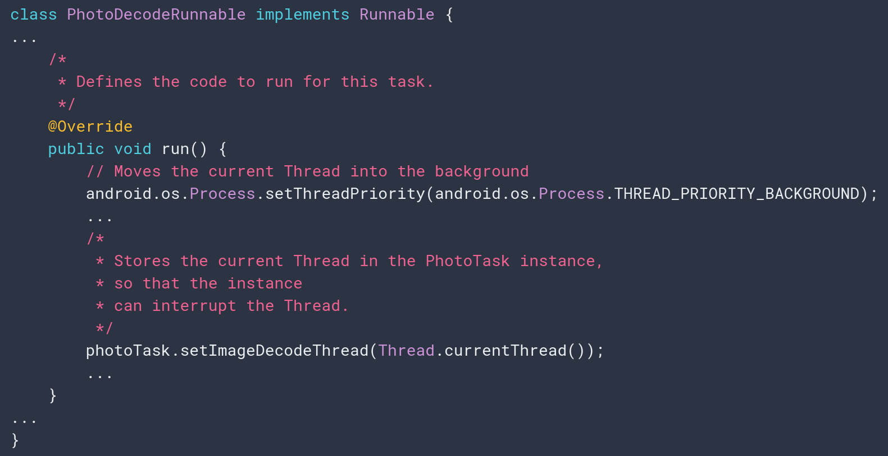
Specifying Code for a Thread
Create a class implementing Runnable
Implement run()
Can’t directly modify View objects.
Set thread priority.
Default: background (prevents competition with UI thread)
Store reference to the connected thread.
Notes:
The speed and efficiency of a long-running, data-intensive operation often improves when you split it into smaller operations running on multiple threads. YOu need to (1), which has a method called “run”. the Runnable.run() method contains the code that's executed. Usually, anything is allowable in a Runnable. Remember, though, that the Runnable won't be running on the UI thread, so it can't directly modify UI objects such as View objects.
At the beginning of the run() method, set the thread to use background priority by calling Process.setThreadPriority() with THREAD_PRIORITY_BACKGROUND. This approach reduces resource competition between the Runnable object's thread and the UI thread.
You should also store a reference to the Runnable object's Thread in the Runnable itself, by calling Thread.currentThread().

Slide 24
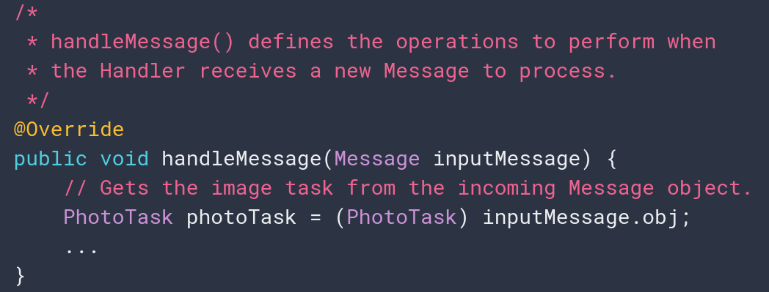
Communicating with UI Thread
AFTER performing work, move results of background processing to UI elements.
Use Handler running on UI thread.
Handlers receive messages and run associated code.
Connect to threads and run code on that thread.
Override handleMessage().
Invoked when message sent to the managed thread.
Notes:
how then do we send data from the task to objects running on the user interface (UI) thread. After task do background work, we need to move the results to UI elements such as bitmaps. Only objects running on the UI thread have access to other objects on that thread. Because tasks that you run on a thread from a thread pool aren't running on your UI thread, they don't have access to UI objects. To move data from a background thread to the UI thread, use a Handler that's running on the UI thread.
Handler is part of the Android system's framework for managing threads. A Handler object receives messages and runs code to handle the messages. Normally, you create a Handler for a new thread, but you can also create a Handler that's connected to an existing thread. When you connect a Handler to your UI thread, the code that handles messages runs on the UI thread.
Inside the Handler, override the handleMessage() method. The Android system invokes this method when it receives a new message for a thread it's managing; all of the Handler objects for a particular thread receive the same message. (code)

Slide 25
Support for Background Processing
WorkManager
Library that runs background tasks when conditions (network availability, battery) are satisfied.
For work that can be put off until later.
Foreground Services
Background process without UI.
Work that must run immediately and be completed.
Prevents OS from killing process.
Notes:
Android offers a variety of options for performing backgrounf processing.
(1) WorkManager is an Android library that gracefully runs deferrable background work when the work's conditions (like network availability and power) are satisfied. For work that is deferrable and expected to run even if your device or application restarts, use WorkManager.
(4-5) For user-initiated work that need to run immediately and must execute to completion, use a foreground service - we’ll talk more about services shortly. Using a foreground service tells the system that the app is doing something important and it shouldn’t be killed. Foreground services are visible to users via a non-dismissible notification in the notification tray.

Slide 26
Support for Background Processing
AlarmManager
Launches a process at a scheduled time.
WorkManager better balances system resources, but AlarmManager is needed for specific timed processes.
Use WorkManager for tasks that execute every hour. Use AlarmManager for tasks executing at 6:38 AM.
DownloadManager
Performs background downloading tasks.
Provide URI, library handles HTTP interactions, retries, connectivity changes.
Notes:
(1) If you need to run a job at a precise time, use AlarmManager. AlarmManager launches your app, if necessary, to do the job at the time you specify. However, if your job does not need to run at a precise time, WorkManager is a better option; WorkManager is better able to balance system resources. For example, if you need to run a job every hour or so, but don't need the job to run at a specific time, you should use WorkManager to set up a recurring job.
(4) If your app is performing long-running HTTP downloads, consider using DownloadManager. Clients may request that a URI be downloaded to a particular destination file that may be outside of the app process. The download manager will conduct the download in the background, taking care of HTTP interactions and retrying downloads after failures or across connectivity changes and system reboots.

Slide 27
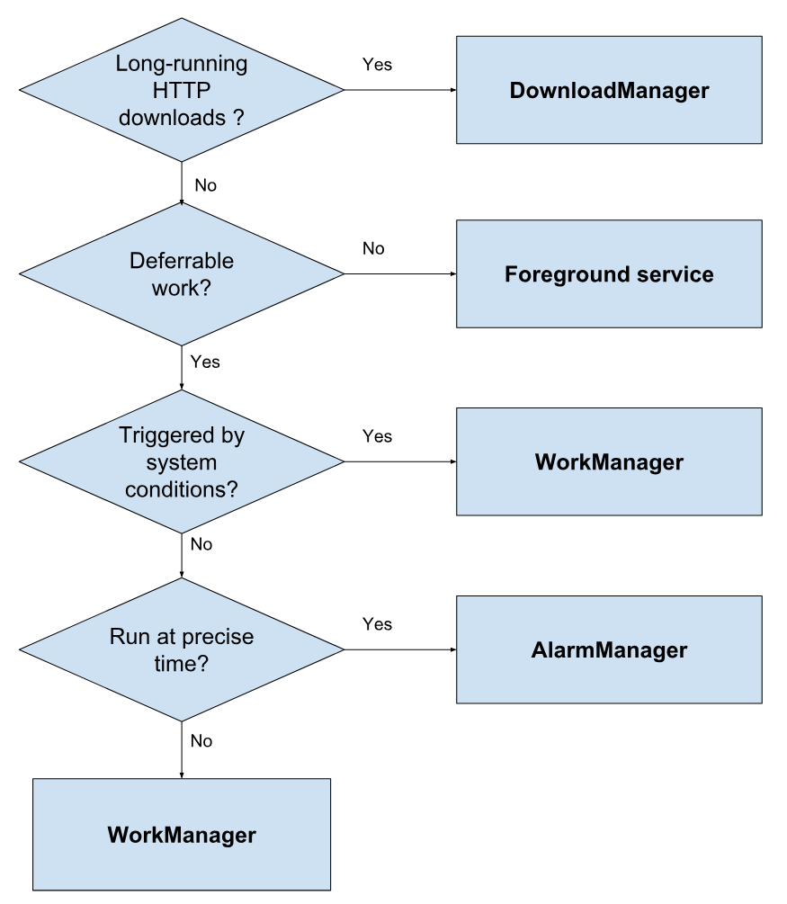
How to Handle Background Tasks
Can the work be deferred, or does it need to happen now?
If not, Foreground Service
Is the work dependent on system conditions?
If yes, WorkManager
Does the job need to run at a precise time?
If yes, AlarmManager. If no, WorkManager
Notes:
HTTP download? Download manager
Can the work be deferred, or does it need to happen right away? For example, if you need to fetch some data from the network in response to the user clicking a button, that work must be done right away. However, if you want to upload your logs to the server, that work can be deferred without affecting your app’s performance or user expectations.
Is the work dependent on system conditions? You might want your job to run only when the device meets certain conditions, such as being connected to power, having internet connectivity, and so on. For example, your app might periodically need to compress its stored data. To avoid affecting the user, you would want this job to happen only when the device is charging and idle.
Does the job need to run at a precise time? A calendar app might let a user set up a reminder for an event at a specific time. The user expects to see the reminder notification at the correct time. In other cases, the app may not care precisely when the job runs. The app might have general requirements—like, "Job A must run first, then Job B, then Job C"—but it doesn't require jobs to run at a specific time.

Slide 28
Let’s Take a Break

Slide 29
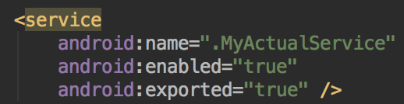

Services
Component in the background, no UI
Often used for long-running operations
Play music
Process data
Send/receive data over the internet
Will continue to run even if user switches to another app.
Started with an Intent
Notes:
A Service is an application component - like Activities - that can perform long-running operations in the background, and it doesn't provide a user interface. Another application component can start a service, and it continues to run in the background even if the user switches to another application. Additionally, a component can bind to a service to interact with it and even perform interprocess communication (IPC). For example, a service can handle network transactions, play music, perform file I/O, or interact with a content provider, all from the background.
any application component can use the service (even from a separate application) in the same way that any component can use an activity—by starting it with an Intent. However, you can declare the service as private in the manifest file and block access from other applications.

Slide 30
Services
Foreground Services
Perform an operation that users notice.
Play music
Must display notification.
Keep running even if user isn’t interacting with them.
Background Services
Perform operation not noticeable to user.
Compress files
Notes:
These are the three different types of services
(1) A foreground service performs some operation that is noticeable to the user. For example, an audio app would use a foreground service to play an audio track. Foreground services must display a Notification. Foreground services continue running even when the user isn't interacting with the app.
(6) A background service performs an operation that isn't directly noticed by the user. For example, if an app used a service to compact its storage, that would usually be a background service.

Slide 31
Bound Services
Service bound to component using bindService()
Offers a client-server interface allowing components to interact with the service.
Send requests/receive results
Across processes (allowing process communication)
Multiple components can be bound to one service.
Service destroyed when all unbind.
Notes:
A service is bound when an application component binds to it by calling bindService(). A bound service offers a client-server interface that allows components to interact with the service, send requests, receive results, and even do so across processes with interprocess communication (IPC). A bound service runs only as long as another application component is bound to it. Multiple components can bind to the service at once, but when all of them unbind, the service is destroyed.

Slide 32
Services vs Threads
Rule of thumb:
Operation should run, even if user doesn't interact with the app (or closes it): Service
Long-running operation, while the user is active: Thread
Example: Alarm clock
Alarm should go off, even if you close the clock app.
Service!
Example: Buffer video
Video should stop if the app is closed.
Thread!
Notes:
A service is simply a component that can run in the background, even when the user is not interacting with your application, so you should create a service only if that is what you need. If you must perform work outside of your main thread, but only while the user is interacting with your application, you should instead create a new thread. Consider an alarm clock. (rest)

Slide 33
Service Basics
Create subclass of Service
Implement lifecycle methods:
onStartCommand()
Invoked when another component requests the Service.
Service is started and will run until stopService() called.
onBind()
Provides interface used to communicate with the Service.
onCreate()
Setup when Service created.
onDestroy()
Cleanup when Service is complete.
Notes:
To create a service, you must create a subclass of Service or use one of its existing subclasses. In your implementation, you must override some callback methods that handle key aspects of the service lifecycle and provide a mechanism that allows the components to bind to the service, if appropriate. These are the most important callback methods that you should override:
(3) The system invokes this method by calling startService() when another component (such as an activity) requests that the service be started. When this method executes, the service is started and can run in the background indefinitely. If you implement this, it is your responsibility to stop the service when its work is complete by calling stopSelf() or stopService(). If you only want to provide binding, you don't need to implement this method.
(6) The system invokes this method by calling bindService() when another component wants to bind with the service (such as to perform RPC). In your implementation of this method, you must provide an interface that clients use to communicate with the service.
(8) The system invokes this method to perform one-time setup procedures when the service is initially created (before it calls either onStartCommand() or onBind()). If the service is already running, this method is not called.
(10) The system invokes this method when the service is no longer used and is being destroyed. Your service should implement this to clean up any resources such as threads, registered listeners, or receivers. This is the last call that the service receives.

Slide 34
Service Basics
If created by call to startService(), Service will run until stopService() is called.
If created by call to bindService(), will run only as long as component is bound to it.
Once all components unbound, system will kill.
OS kills Services only if memory is low.
Foreground services rarely killed.
Services must be designed to gracefully restart if killed before finished with task.
Notes:
If a component starts the service by calling startService() (which results in a call to onStartCommand()), the service continues to run until it stops itself with stopSelf() or another component stops it by calling stopService().
If a component calls bindService() to create the service and onStartCommand() is not called, the service runs only as long as the component is bound to it. After the service is unbound from all of its clients, the system destroys it.
The Android system stops a service only when memory is low and it must recover system resources for the activity that has user focus. If the service is bound to an activity that has user focus, it's less likely to be killed; if the service is declared to run in the foreground, it's rarely killed. If the service is started and is long-running, the system lowers its position in the list of background tasks over time, and the service becomes highly susceptible to killing—if your service is started, you must design it to gracefully handle restarts by the system. If the system kills your service, it restarts it as soon as resources become available

Slide 35
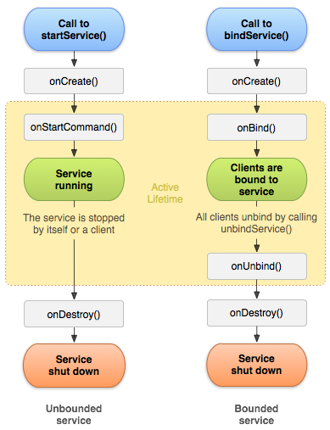
Service Lifecycle
Lifetime occurs between call to onCreate() and return from onDestroy()
Active lifetime begins with call to onStartCommand() or onBind().
Intent handed to service and acted on.
Started services can be bound.
Notes:
The entire lifetime of a service occurs between the time that onCreate() is called and the time that onDestroy() returns. Like an activity, a service does its initial setup in onCreate() and releases all remaining resources in onDestroy(). For example, a music playback service can create the thread where the music is played in onCreate(), and then it can stop the thread in onDestroy().The active lifetime of a service begins with a call to either onStartCommand() or onBind(). Each method is handed the Intent that was passed to either startService() or bindService().
If the service is started, the active lifetime ends at the same time that the entire lifetime ends (the service is still active even after onStartCommand() returns). If the service is bound, the active lifetime ends when onUnbind() returns.
Although the figure separates services that are created by startService() from those created by bindService(), keep in mind that any service, no matter how it's started, can potentially allow clients to bind to it. A service that was initially started with onStartCommand() (by a client calling startService()) can still receive a call to onBind() (when a client calls bindService()).

Slide 36
Services vs IntentServices
Services are multi-threaded and handle requests from multiple components simultaneously.
Most Services are extensions of IntentServices
Creates a worker thread that executes all Intents delivered to onStartCommand().
Creates a work queue to perform requests.
Stops service once all requests are handled.
Provides default implementations of onBind() and onStartCommand().
Notes:
(1), this is actually a difficult and dangerous multi-threading scenerio. Instead of extending the powerful, but hard to use Services class, (2). The IntentService class does the following:
It creates a default worker thread that executes all of the intents that are delivered to onStartCommand(), separate from your application's main thread.
Creates a work queue that passes one intent at a time to your implementation, so you never have to worry about multi-threading.
Stops the service after all of the start requests are handled, so you never have to call stopSelf().
Provides a default implementation of onBind() that returns null. Provides a default implementation of onStartCommand() that sends the intent to the work queue and then to your implementation.

Slide 37
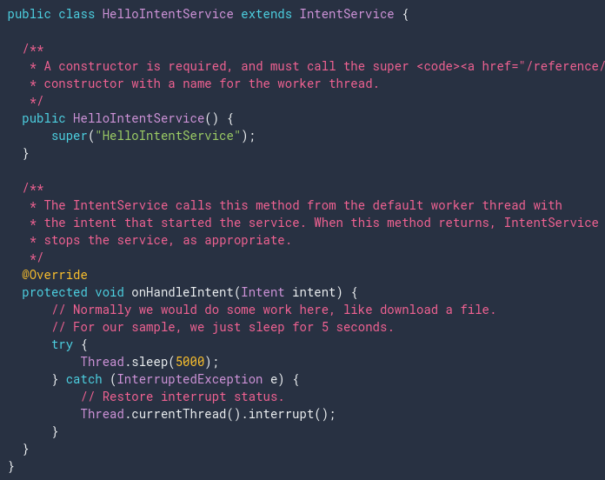
IntentServices
onHandleIntent()
Performs tasks
Returns result
Stops the service
Notes:
To complete the work that is provided by the client, implement onHandleIntent(). However, you also need to provide a small constructor for the service. When the work queue arrives at a request, onHandleIntent recieves the request, performs the work, and returns the result.

Slide 38
Word of Warning
Services are difficult to get right!
Much more to cover than fit the slides/time
If you want to implement a service, read up on what you need to know:
https://developer.android.com/guide/components/services

Slide 39
Broadcast Receivers
Apps may send or receive broadcasts from the OS or other apps.
Sent when events of interest occur.
Phone plugged into power outlet.
Apps can register to receive specific broadcasts.
OS routes broadcasts to registered apps.
Messaging system across apps.
Allows starting and stopping of Services.
Notes:
Android apps can send or receive broadcast messages from the Android system and other Android apps, similar to the publish-subscribe design pattern. These broadcasts are sent when an event of interest occurs. For example, the Android system sends broadcasts when various system events occur, such as when the system boots up or the device starts charging. Apps can also send custom broadcasts, for example, to notify other apps of something that they might be interested in (for example, some new data has been downloaded).
Apps can register to receive specific broadcasts. When a broadcast is sent, the system automatically routes broadcasts to apps that have subscribed to receive that particular type of broadcast.
Generally speaking, broadcasts can be used as a messaging system across apps and outside of the normal user flow. However, you must be careful not to abuse the opportunity to respond to broadcasts and run jobs in the background that can contribute to a slow system performance, as described in the following video.

Slide 40
Broadcasts
Sent to all apps registered to receive the event.
Message wrapped in Intent object.
Action string identifies the event.
android.intent.action.AIRPLANE_MODE
May include additional contextual information.
Boolean indicating whether or not airplane mode is on.
Complete list of broadcast actions in Android SDK
BROADCAST_ACTIONS.TXT
Notes:
System broadcasts are sent to all apps that are subscribed to receive the event.
The broadcast message itself is wrapped in an Intent object whose action string identifies the event that occurred (for example android.intent.action.AIRPLANE_MODE). The intent may also include additional information bundled into its extra field. For example, the airplane mode intent includes a boolean extra that indicates whether or not Airplane Mode is on.

Slide 41
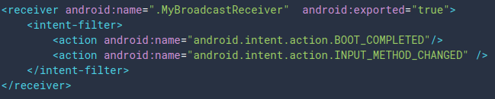
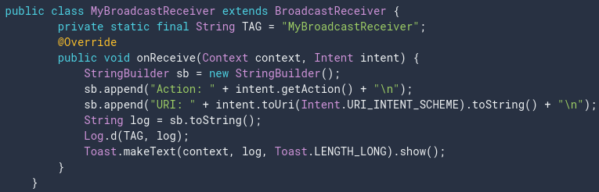
Manifest-Declared Receivers
System launches app when broadcast is sent.
Specify <receiver> element in manifest.
Subclass BroadcastReceiver and implement onReceive(Context, Intent).
Notes:
Apps can receive broadcasts in two ways: through manifest-declared receivers and context-registered receivers. If you declare a broadcast receiver in your manifest, the system launches your app (if the app is not already running) when the broadcast is sent.
To declare a broadcast receiver in the manifest, Specify the <receiver> element in your app's manifest. (go over code)The intent filters specify the broadcast actions your receiver subscribes to.
Subclass BroadcastReceiver and implement onReceive(Context, Intent). The broadcast receiver in the example logs and displays the contents of the broadcast: (code)
The system package manager registers the receiver when the app is installed. The receiver then becomes a separate entry point into your app which means that the system can start the app and deliver the broadcast if the app is not currently running.

Slide 42
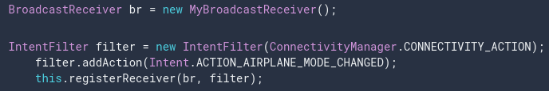
Context-Registered Receivers
Receive broadcasts as long as the context is valid.
Receive broadcasts as long as Activity is not destroyed, or as long as the app is running, or …
Within the context:
Create an instance of BroadcastReceiver
Create an IntentFilter and register the receiver
Notes:
(title) are based on a particular environment. Context-registered receivers receive broadcasts as long as their registering context is valid. For an example, if you register within an Activity context, you receive broadcasts as long as the activity is not destroyed. If you register with the Application context, you receive broadcasts as long as the app is running.
(3-5)
Context-registered receivers receive broadcasts as long as their registering context is valid. For an example, if you register within an Activity context, you receive broadcasts as long as the activity is not destroyed. If you register with the Application context, you receive broadcasts as long as the app is running.To stop receiving broadcasts, call unregisterReceiver(android.content.BroadcastReceiver). Be sure to unregister the receiver when you no longer need it or the context is no longer valid.

Slide 43
Sending Broadcasts
sendOrderedBroadcast(Intent, String)
Sends broadcasts to one receiver at a time.
Each receiver can build on the result or abort the broadcast.
sendBroadcast(Intent)
Sends broadcasts to all receivers in undefined order.
“Normal” mode.
Efficient, but can’t be filtered, aborted, or modified by intermediate receivers.
Notes:
Android provides three ways for apps to send broadcast:
The sendOrderedBroadcast(Intent, String) method sends broadcasts to one receiver at a time. As each receiver executes in turn, it can propagate a result to the next receiver, or it can completely abort the broadcast so that it won't be passed to other receivers. The order receivers run in can be controlled; receivers with the same priority will be run in an arbitrary order.
The sendBroadcast(Intent) method sends broadcasts to all receivers in an undefined order. This is called a Normal Broadcast. This is more efficient, but means that receivers cannot read results from other receivers, propagate data received from the broadcast, or abort the broadcast.

Slide 44
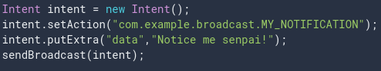
Sending Broadcasts
sendBroadcast(Intent)
LocalBroadcastManager.sendBroadcast(Intent)
Sends broadcasts in the same app as sender.
Much more efficient, no security issues.
Notes:
The following code snippet demonstrates how to send a broadcast by creating an Intent and calling sendBroadcast(Intent). The broadcast message is wrapped in an Intent object. The intent's action string must provide the app's Java package name syntax and uniquely identify the broadcast event. You can attach additional information to the intent with putExtra(String, Bundle). You can also limit a broadcast to a set of apps in the same organization by calling setPackage(String) on the intent.
The LocalBroadcastManager.sendBroadcast method sends broadcasts to receivers that are in the same app as the sender. If you don't need to send broadcasts across apps, use local broadcasts. The implementation is much more efficient (no interprocess communication needed) and you don't need to worry about any security issues related to other apps being able to receive or send your broadcasts.

Slide 45
Broadcast Best Practices
Use local broadcasts as general purpose publisher/subscriber method in app.
If many apps subscribe to a broadcast in manifest, they will all launch when broadcast is sent.
Use context-registered receivers to add restrictions.
Android forces the use of context in some cases.
Do not broadcast sensitive information with implicit intents. Specify permissions, packages, or use local broadcasts.
Notes:
If you don't need to send broadcasts to components outside of your app, then send and receive local broadcasts. Local Broadcasts can be used as a general purpose pub/sub event bus in your app without any overheads of system wide broadcasts.
If many apps have registered to receive the same broadcast in their manifest, it can cause the system to launch a lot of apps, causing a substantial impact on both device performance and user experience. To avoid this, prefer using context registration over manifest declaration. Sometimes, the Android system itself enforces the use of context-registered receivers. For example, the CONNECTIVITY_ACTION broadcast is delivered only to context-registered receivers.
Do not broadcast sensitive information using an implicit intent. The information can be read by any app that registers to receive the broadcast. Instead, you can specify a permission when sending a broadcast. you can specify a package with setPackage(String) when sending a broadcast. The system restricts the broadcast to the set of apps that match the package. You can send local broadcasts.

Slide 46
Broadcast Best Practices
Apps can send malicious broadcasts.
Use permissions to block broadcasts, declare “android:exported” false in manifest, use local broadcasts
Broadcasts use global namespace.
Be careful not to conflict when naming.
onReceive(..) runs on main thread.
Should execute and return quickly.
Do not start activities from broadcast receivers.
Notifications are more common.
Notes:
When you register a receiver, any app can send potentially malicious broadcasts to your app's receiver. There are three ways to limit the broadcasts that your app receives: You can specify a permission when registering a broadcast receiver. For manifest-declared receivers, you can set the android:exported attribute to "false" in the manifest. The receiver does not receive broadcasts from sources outside of the app. You can limit yourself to only local broadcasts.
The namespace for broadcast actions is global. Make sure that action names and other strings are written in a namespace you own, or else you may inadvertently conflict with other apps.
Because a receiver's onReceive(Context, Intent) method runs on the main thread, it should execute and return quickly. If you need to perform long running work, be careful about spawning threads or starting background services because the system can kill the entire process after onReceive() returns.
Do not start activities from broadcast receivers because the user experience is jarring; especially if there is more than one receiver. Instead, consider displaying a notification.

Slide 47
Content Providers

Slide 48
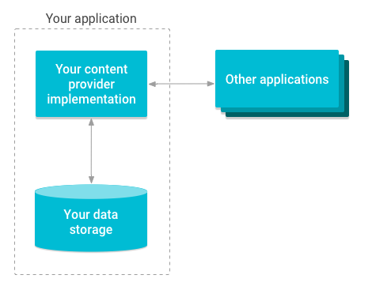
Content Providers
Provides an interface to a protected data resource.
Primarily used to share data with other apps in a secure manner.
Offer a standard interface for interprocess data sharing.
Used when you want to access data stored by another app or share data from your app.
Notes:
A content provider manages access to a central repository of data.Content providers can help an application manage access to data stored by itself, stored by other apps, and provide a way to share data with other apps. They encapsulate the data, and provide mechanisms for defining data security. A provider is part of an Android application, which often provides its own UI for working with the data. However, content providers are primarily intended to be used by other applications, which access the provider using a provider client object. Together, providers and provider clients offer a consistent, standard interface to data that also handles inter-process communication and secure data access. Typically you work with content providers in one of two scenarios; you may want to implement code to access an existing content provider in another application, or you may want to create a new content provider in your application to share data with other applications.

Slide 49
Content Provider Advantages
Offer control over permissions for accessing data.
Can restrict access from within your application, grant access to other applications.
Control reading and writing of data.
Abstracts details of how data is accessed.
Data storage type does not matter.
CursorLoader objects offer seamless way to query Content Providers to fill UI elements.
Notes:
Content providers offer granular control over the permissions for accessing data. You can choose to restrict access to a content provider from solely within your application, grant blanket permission to access data from other applications, or configure different permissions for reading and writing data.
You can use a content provider to abstract away the details for accessing different data sources in your application. For example, your application might store structured records in a SQLite database, as well as video and audio files. You can use a content provider to access all of this data, if you implement this development pattern in your application.
CursorLoader objects use content providers to run asynchronous queries and then return the results to the UI layer in your application. This offers an easy way to load data into a UI in a seamless way, where you can swap out different data sources.

Slide 50
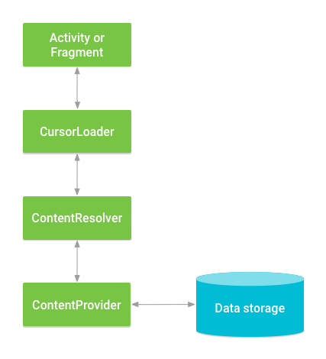
Accessing Content Providers
You use a ContentResolver to communicate with the other app’s ContentProvider.
ContentProvider receives data requests and returns results.
ContentResolver provides CRUD functions.
Commonly, a CursorLoader runs a query in the background.
Activity calls CursorLoader,
CursorLoader delegates to ContentResolver.
ContentResolver works with ContentProvider.
This is performed in the background.
Your App
Notes:
When you want to access data in a content provider, you use the ContentResolver object in your application's Context to communicate with the provider as a client. The ContentResolver object communicates with the provider object, an instance of a class that implements ContentProvider. The provider object receives data requests from clients, and returns the results. This object has methods that call identically-named methods in the provider object. The ContentResolver methods provide the basic "CRUD" (create, retrieve, update, and delete) functions of persistent storage.
A common pattern for accessing a ContentProvider from your UI uses a CursorLoader to run an asynchronous query in the background. The Activity or Fragment in your UI call a CursorLoader to the query, which in turn gets the ContentProvider using the ContentResolver. This allows the UI to continue to be available to the user while the query is running.

Slide 51
Accessing Content Providers
Android has several built-in Content Providers.
One example: user dictionary
Rows = words not in a standard dictionary
Columns = data attributes associated with the word
Includes primary key ID
To access, call ContentResolver.query().
Calls ContentProvider.query() defined by the app surfacing the provider.
Notes:
(1) One of the built-in providers in the Android platform is the user dictionary, which stores the spellings of non-standard words that the user wants to keep. Each row represents an instance of a word that might not be found in a standard dictionary. Each column represents some data for that word, such as the language setting of the keyboard.
To get a list of the words and their locales from the User Dictionary Provider, you call ContentResolver.query(). The query() method calls the ContentProvider.query() method defined by the User Dictionary Provider.

Slide 52
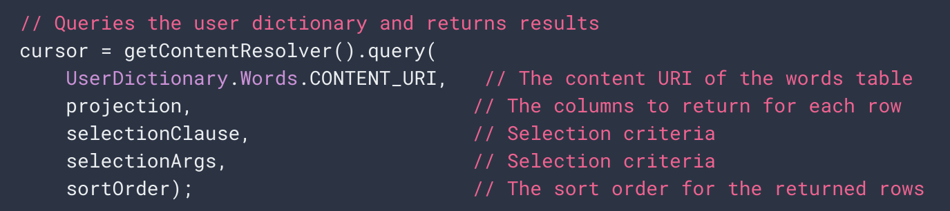
Access Example
Where is the content stored?
Array of columns. What format do you want the result in?
Predicate to filter data. What rows are selected?
Additional optional arguments to filter data (handle missing data, etc.)
How should elements be ordered?
Notes:
The following lines of code show a ContentResolver.query() call.

Slide 53
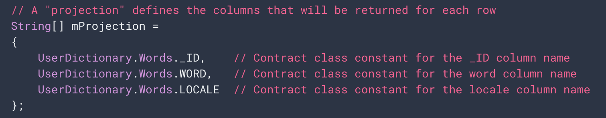
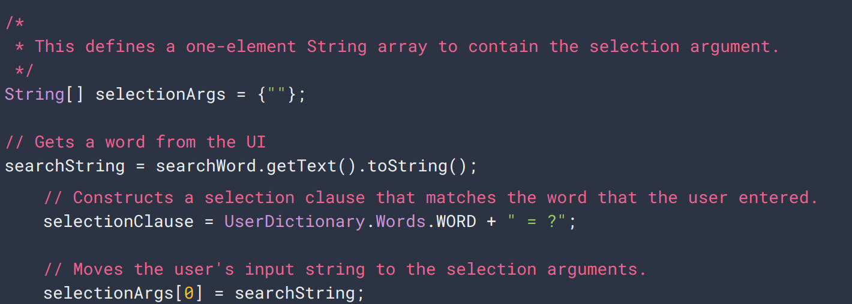
Access Example
The fields that we want in the result (the projection)
Does the entry match the first element of the argument array?
Notes:
Lets use the user dictionary as an example. Lets defines some variables for accessing the User Dictionary Provider A provider client query is similar to an SQL query, and it contains a set of columns to return, a set of selection criteria, and a sort order.
The set of columns that the query should return is called a projection (the variable mProjection).
The expression that specifies the rows to retrieve is split into a selection clause and selection arguments. The selection clause is a combination of logical and Boolean expressions, column names, and values (the variable mSelectionClause). If you specify the replaceable parameter ? instead of a value, the query method retrieves the value from the selection arguments array (the variable mSelectionArgs). If the user enters a word, the selection clause is set to UserDictionary.Words.WORD + " = ?" and the first element of selection arguments array is set to the word the user enters.

Slide 54
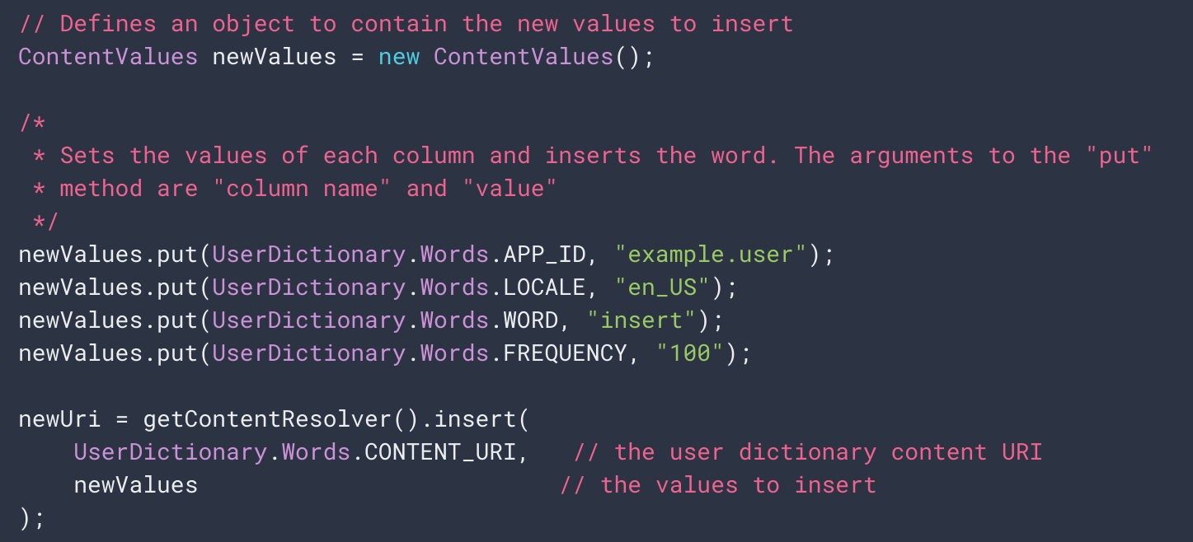
Inserting Data
Notes:
To insert data into a provider, you call the ContentResolver.insert() method. This method inserts a new row into the provider and returns a content URI for that row.The data for the new row goes into a single ContentValues object, which is similar in form to a one-row cursor. The snippet doesn't add the _ID column, because this column is maintained automatically. The provider assigns a unique value of _ID to every row that is added.
(go over example)

Slide 55
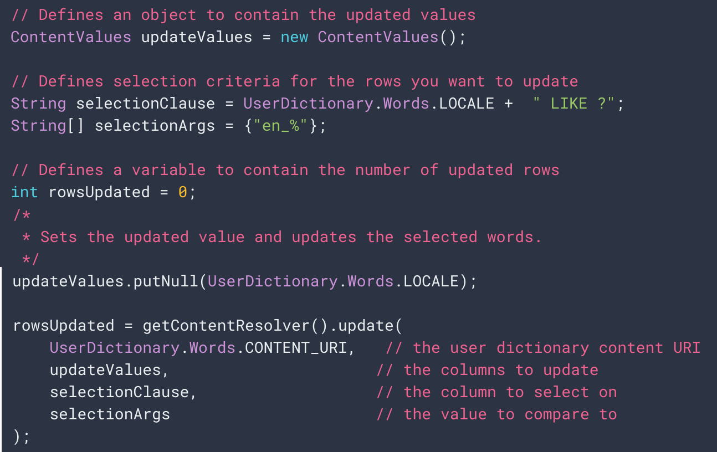
Updating Data
Combines updated values (like insertion) with selection criteria (like a query).
Notes:
To update a row, you use a ContentValues object with the updated values just as you do with an insertion, and selection criteria just as you do with a query. The client method you use is ContentResolver.update(). You only need to add values to the ContentValues object for columns you're updating. If you want to clear the contents of a column, set the value to null.The following snippet changes all the rows whose locale has the language "en" to a have a locale of null. The return value is the number of rows that were updated: (LIKE is a partial match)

Slide 56
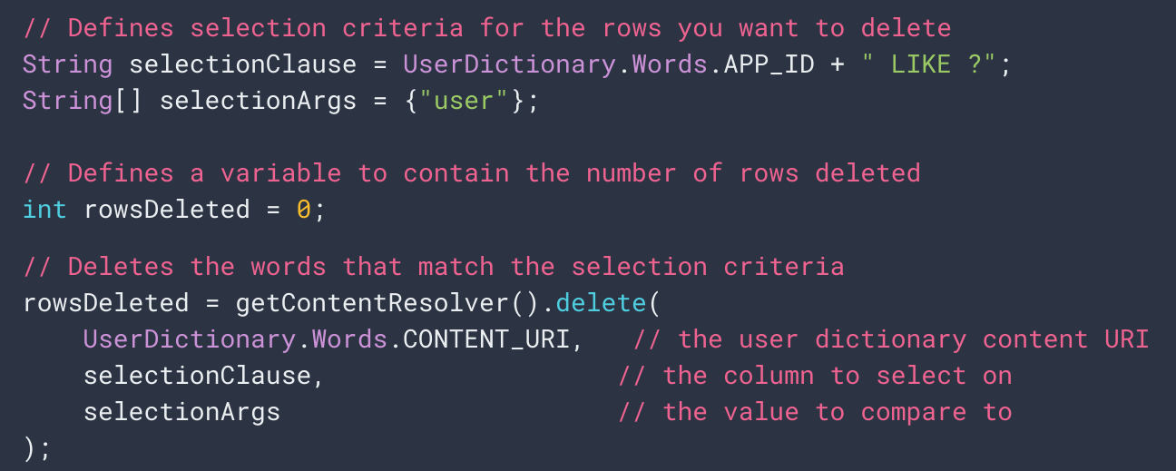
Delete Data
Notes:
Deleting rows is similar to retrieving row data: you specify selection criteria for the rows you want to delete and the client method returns the number of deleted rows. The following snippet deletes rows whose appid matches "user". The method returns the number of deleted rows.

Slide 57
Not Covered
So much more!
Creating ContentProviders
Notifications
Security
Packaging/Signing/Publishing Apps
App Versions
…
More resources: https://developer.android.com/

Slide 58
What’s Next?
Friday: Project Follow-Up
Monday: Cloud Deployment
Milestone 3
Android + Presentation

